Slide 1
Library Project
Colton Parry
Karl Schuelke
Michael Kennard
Scott Weber

Slide 2
Software Demonstration / Requirements
1. The book data is stored in a file (poor man’s database). When the program starts, it reads the data from the file. Allow the user to select the file name. When the program exits, it writes the data back out to the file.
2. The books are of the following types (with their loan times):
3. There are two types of patrons: Adults and Children. Children may only check out children’s books.
4. Check out, Check in
5. Book List, Overdue Books, Patrons book list
6. Date (previously illistrated)
7. Interface: Command Line Interface (CLI)

Slide 3
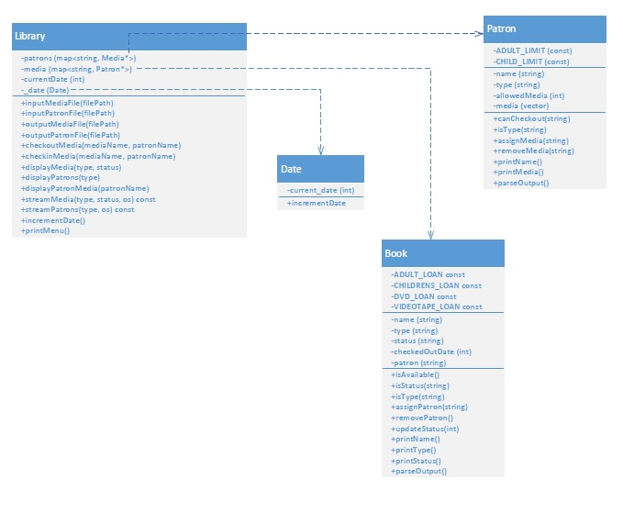
Library Project Design

Slide 4
Testing the Library Project
Unit and Integration Tests.
Testing environment
Testing Results

